Slide 1


Comparative Study
Handwritten Digit Classification Using SVM and Random Forest

Slide 2


Problem Statement
Classifying Handwritten Digits:
Evaluating SVMs vs. Random Forests
• Task: label digit images
• Compare accuracy, speed, and robustness
• Discuss strengths, weaknesses, and when to use each

Slide 3

Problem Motivation
  Essential for automating handwritten digit processing
  Improves efficiency in banking systems (cheque reading, form processing)
  Enhances postal services through automated mail sorting
  Supports various automated systems requiring fast and accurate digit interpretation
  Reduces manual workload and errors in real-world applications

Slide 4
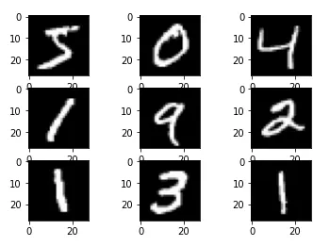
MNIST Dataset
  The MNIST dataset consists of 70,000 images of handwritten digits, serving as a widely recognized benchmark for classification tasks.
  In those 70,000 images 60,000 are used for training and 10,000 are used for testing
  The data set is balanced arcoss 10 classes(digits 0-9)

Slide 5
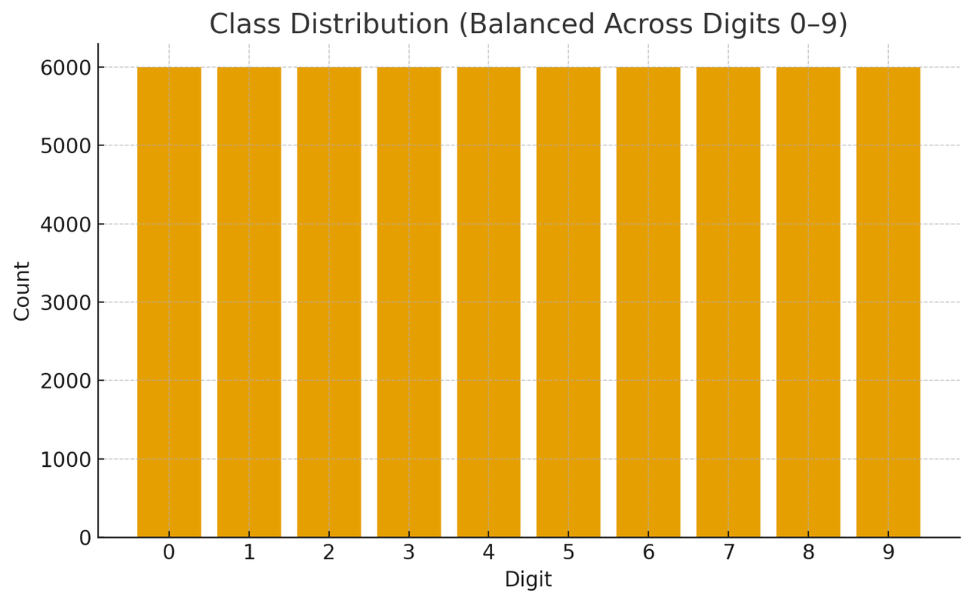
Exploratory Data Analysis
  Dataset shows balanced class distribution
  Distinct pixel intensity patterns observed across digits
  Highlights natural handwriting variations among samples
  Supports reliable model training and performance evaluation

Slide 6
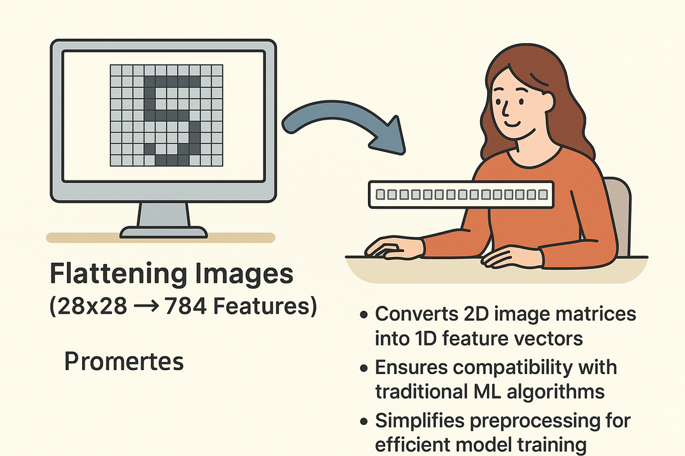
Preprocessing Steps
  Images are flattened from 28×28 pixels into 784 features
  Converts 2D image matrices into 1D feature vectors
  Ensures compatibility with traditional ML algorithms
  Simplifies preprocessing for efficient model training

Slide 7
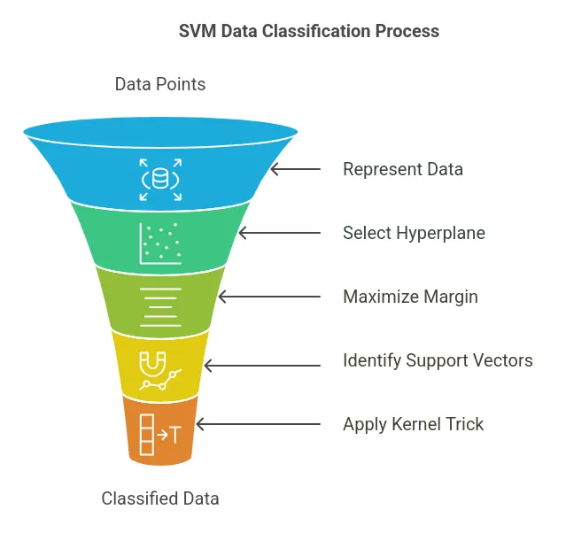
Support Vector Machine
  SVM uses the kernel trick to form nonlinear decision boundaries
  Effectively handles complex and overlapping handwritten digit patterns
  Works well with high-dimensional feature spaces
  Provides robust generalization even with limited training data
  Achieves high accuracy when paired with optimized kernels (e.g., RBF)
  Less prone to overfitting compared to many other classifiers

Slide 8
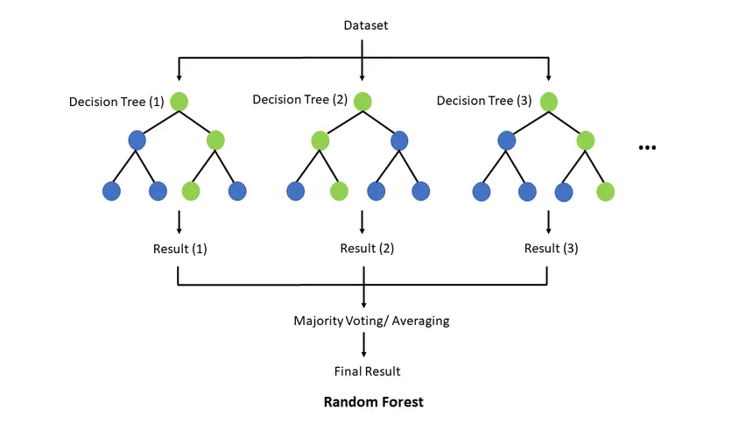
Random Forest Classification
  Random Forest model constructed using 200 decision trees
  Improves prediction accuracy through ensemble voting
  Reduces overfitting compared to single decision trees
  Handles noisy and high-dimensional data effectively
  Provides feature importance insights for better interpretability

Slide 9
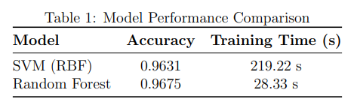
Performance Comparison
The results indicate that RF significantly outperforms SVMs, highlighting the effectiveness of classical machine learning techniques.

Slide 10
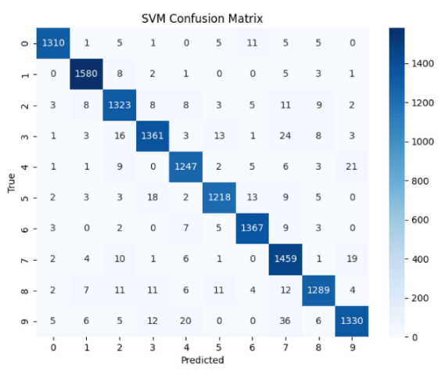
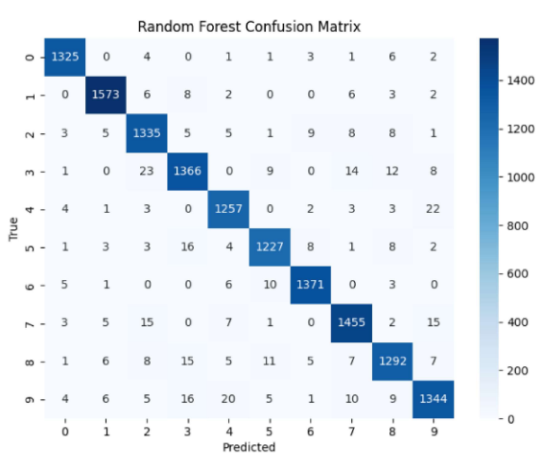
Confusion Matrix
The analysis reveals distinct error patterns, highlighting SVM's clarity in predictions compared to RF’s challenges with similar digits.

Slide 11


Common misclassifications
Error Analysis
  Misclassifications occur due to handwriting variations, lead to inconsistent character shapes
  Pixel noise introduces distortions in input images
  Overlapping strokes make character boundaries unclear
  These factors collectively reduce model accuracy and performance

Slide 12

Conclusion
  Both SVM and Random Forest successfully classified the MNIST handwritten digit dataset.
  Random Forest outperformed SVM in this experiment, delivering better accuracy and faster training time.
  Model selection should depend on dataset size, required accuracy, interpretability, and computational constraints.
  SVM is suitable for small dimensional datasets.
  Random Forest is efficient, scalable, and robust for general-purpose classification.

